Slide 1

Python
Python is a general purpose programming language that is often applied in scripting roles.
So, Python is programming language as well as scripting language.
Python is also called as Interpreted language
Python is developed by Guido van Rossum in 1989.
Python is a very simple programming language so even if you are new to programming, you can learn python without facing any issues.

Slide 2
Python
Program
a program is executed (i.e. the source is first compiled, and the result of that compilation is expected)
A "program" in general, is a sequence of instructions written so that a computer can perform certain task.
Scripting
a script is interpreted
A "script" is code written in a scripting language. A scripting language is nothing but a type of programming language in which we can write code to control
another software application.

Slide 3
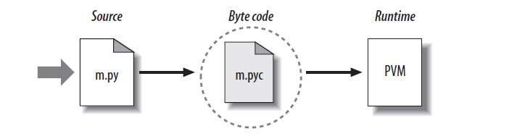
Python
Python Code Execution
Python’s traditional runtime execution model: source code you type is translated to byte code, which is then run by the Python Virtual Machine. Your code is automatically compiled, but then it is interpreted.
Source code extension is .py
Byte code extension is .pyc (compiled python code)

Slide 4
Python
Features of Python
1. Readable: Python is a very readable language.
2. Easy to Learn: python is a expressive and high level programming language, it is easy to understand.
3. Cross platform: Python can run on various operating systems such as Mac, Windows, Linux, Unix etc. This makes it a cross platform and portable language.
4. Open Source: Python is a open source programming language.
5. Large standard library: Python comes with a large standard library that has some handy codes and functions which we can use while writing code in Python.
6. Free: Python is free to download and use. You can download it for free and use it in your application

Slide 5
Python
Features of Python
7. Supports exception handling: An exception is an event that can occur during program exception and can disrupt the normal flow of program. Python supports exception handling which means we can write less error prone code and can test various scenarios that can cause an exception later on.
8. Advanced features: Supports generators and list comprehensions.
9. Automatic memory management: Python supports automatic memory management which means the memory is cleared automatically.

Slide 6
Python
Applications of Python
1. Web development – Web framework like Django and Flask are based on Python. They help you write server side code which helps you manage database, write backend programming logic, mapping urls etc.
2. Machine learning – There are many machine learning applications written in Python. Machine learning is a way to write a logic so that a machine can learn and solve a particular problem on its own.
3. Data Analysis – Data analysis and data visualization in form of charts can also be developed using Python.
4. Scripting – Scripting is writing small programs to automate simple tasks such as sending automated response emails etc
5. Game development – You can develop games using Python.
6. Embedded applications - You can develop Embedded applications in Python.
7. Desktop applications – You can develop desktop application in Python using library like TKinter or QT.

Slide 7
Python
Python comments
A comment is text that doesn’t affect the outcome of a code, it is just a piece of text to let someone know what you have done in a program or what is being done in a block of code.
There are two types of comments in Python. 1. Single line comment 2. Multiple line comment
Single line comment
we use # special character to start the comment.
Multi-line comment:
we use triple single quotes at the beginning and at the end of the comment.

Slide 8
Python
Python Keywords
Keywords are the reserved words in Python.
We cannot use a keyword as a variable name, function name or any other identifier. They are used to define the syntax and structure of the Python language.
In Python, keywords are case sensitive.
There are 33 keywords in Python 3.7. This number can vary slightly over the course of time.
All the keywords except True, False and None are in lowercase and they must be written as they are. The list of all the keywords is given below.

Slide 9
Python
Python Keywords List
False | await | else | import | pass
None | break | except | in | raise
True | class | finally | is | return
and | continue | for | lambda | try
as | def | from | nonlocal | while
assert | del | global | not | with
async | elif | if | or | yield

Slide 10
Python
Python Statement
Instructions that a Python interpreter can execute are called statements.
For example, a = 1 is an assignment statement.
Multi-line statement
In Python, the end of a statement is marked by a newline character. But we can make a statement extend over multiple lines with the line continuation character (\).
For example:
a = 1 + 2 + 3 + \
4 + 5 + 6 + \
7 + 8 + 9

Slide 11
Python
Python Statement
This is an explicit line continuation. In Python, line continuation is implied inside parentheses ( ), brackets [ ], and braces { }. For instance, we can implement the above multi-line statement as:
a = (1 + 2 + 3 +
4 + 5 + 6 +
7 + 8 + 9)

Slide 12
Python
Python Indentation
Most of the programming languages like C, C++, and Java use braces { } to define a block of code. Python, however, uses indentation.
A code block (body of a function, loop, etc.) starts with indentation and ends with the first un-indented line. The amount of indentation is up to you, but it must be consistent throughout that block.
Generally, four whitespaces are used for indentation and are preferred over tabs. Here is an example.
for i in range(1,11):
print(i)
if i == 5:
break

Slide 13
Python
Python Variables
Variables are used to store data, they take memory space based on the type of value we assigning to them.
You do not have to explicitly mention the type of the variable, python infer the type based on the value we are assigning.
Ex:
abc = 225 #num is of type int
str = “saibaba" #str is of type string

Slide 14
Python
Variable name – Identifiers
Variable name is known as identifier. There are few rules that you have to follow while naming the variables in Python. 1. The name of the variable must always start with either a letter or an underscore (_). For example: _str, str, num, _num are all valid name for the variables. 2. The name of the variable cannot start with a number. For example: 9num is not a valid variable name. 3. The name of the variable cannot have special characters such as %, $, # etc, they can only have alphanumeric characters and underscore (A to Z, a to z, 0-9 or _ ). 4. Variable name is case sensitive in Python which means num and NUM are two different variables in python.

Slide 15
Python
Variable Example
abc = 126
str = “Dr Kumar“
bca= 254.65
Type(abc)
print(abc)
print(str)
Print(bca)

Slide 16
Python
Multiple assignment
We can assign multiple variables in a single statement like this in Python.
x = y = z = 55
print(x)
print(y)
print(z)
id(x)
a, b, c = 5, 6, 7
print(a)
print(b)
print(c)

Slide 17
Python
Concatenation operation on the variables
x = 45
y = 49
print(x + y)
a = "Hello“
b = "World“
print(a + " " + b)

Slide 18
Python
Converting between datatypes
For example, '123' is of str type and it can be converted to integer using int function.
a = '123'
b = int(a)
Converting from a float string such as '123.456' can be done using float function.
a = '123.456'
b = float(a)
c = int(a) # ValueError: invalid literal for int() with base 10: '123.456'
d = int(b) # 123

Slide 19
Python
Mutable and Immutable Data Types
An object is called mutable if it can be changed. For example, when you pass a list to some function, the list can be changed.
An object is called immutable if it cannot be changed in any way. For example, integers are immutable, since there’s no way to change them.
Data types whose instances are mutable are called mutable data types, and similarly for immutable objects and datatypes.
Examples of immutable Data Types:
int, long, float, complex, str, bytes, tuple, frozenset
Examples of mutable Data Types:
Bytearray, list, set, dict

Slide 20
Python
Print function
print('End with a new line char.')
print('Print', 'multiple', 'strings.')
print('End with a space.', end=' ')
print() # print a new line char
print('Print’,’\t’, 'multiple', ’\t’, 'strings.')
print('print','\n','multiple','\n','lines')

Slide 21
Python
Print function
print('End with a new line char.')
print('Print', 'multiple', 'strings.')
print('End with a space.', end=' ')
print() # print a new line char
print('Print’,’\t’, 'multiple', ’\t’, 'strings.')
print('print','\n','multiple','\n','lines')

Slide 22
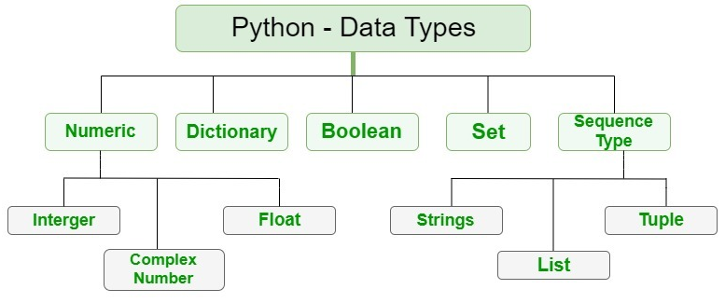
Python – Data Types
Numeric data type

Slide 23
Python – Data Types
Numeric data type
A numeric value is any representation of data which has a numeric value. Python identifies three types of numbers:
Integer: Positive or negative whole numbers (without a fractional part)
a = 5
print("Type of a: ", type(a))
Float: Any real number with a floating point representation in which a fractional component is denoted by a decimal symbol or scientific notation
b = 5.0
print("\nType of b: ", type(b))

Slide 24
Python – Data Types
Numeric data type
The following strings can be prepended to an integer value to indicate a base other than 10.
Prefix | Interpretation | Base
0b (zero + lowercase letter 'b') 0B (zero + uppercase letter 'B') | Binary | 2
0o (zero + lowercase letter 'o') 0O (zero + uppercase letter 'O') | Octal | 8
0x (zero + lowercase letter 'x') 0X (zero + uppercase letter 'X') | Hexadecimal | 16
>>> print(0b10)
2
>>> print(0o10)
8
>>> print(0x10)
16

Slide 25
Python – Data Types
Numeric data type
Complex number: A number with a real and imaginary component represented as x+yj. x and y are floats and j is -1(square root of -1 called an imaginary number)
c = 2 + 4j
print("\nType of c: ", type(c))
Exponential:
>>> .4e4
4000.0
>>> 6e2
600.0

Slide 26
Python – Data Types
Boolean Type
Boolean type have one of two values, True or False
>>> a=True
>>> print(a)
True
>>> type(a)
<class 'bool'>

Slide 27
Python – Built-In Functions
Math functions
Function | Description
abs() | Returns absolute value of a number
divmod() | Returns quotient and remainder of integer division
max() | Returns the largest of the given arguments or items in an iterable
min() | Returns the smallest of the given arguments or items in an iterable
pow() | Raises a number to a power
round() | Rounds a floating-point value
sum() | Sums the items of an iterable

Slide 28
Python – Type Conversion
Function | Description
ascii() | Returns a string containing a printable representation of an object
bin() | Converts an integer to a binary string
bool() | Converts an argument to a Boolean value
chr() | Returns string representation of character given by integer argument
complex() | Returns a complex number constructed from arguments
float() | Returns a floating-point object constructed from a number or string
hex() | Converts an integer to a hexadecimal string
int() | Returns an integer object constructed from a number or string
oct() | Converts an integer to an octal string
ord() | Returns integer representation of a character
repr() | Returns a string containing a printable representation of an object
str() | Returns a string version of an object
type() | Returns the type of an object or creates a new type object

Slide 29
Python Operators
Python provides a variety of operators described as follows.
Arithmetic operators
Comparison operators
Assignment Operators
Logical Operators
Bitwise Operators
Membership Operators
Identity Operators

Slide 30
Arithmetic operators
Arithmetic operators are used to perform arithmetic operations between two operands. It includes +(addition), - (subtraction), *(multiplication), /(divide), %(reminder), //(floor division), and exponent (**).
Operator | Description
+ (Addition) | It is used to add two operands. For example, if a = 20, b = 10 => a+b = 30
- (Subtraction) | It is used to subtract the second operand from the first operand. If the first operand is less than the second operand, the value result negative. For example, if a = 20, b = 10 => a ? b = 10
/ (divide) | It returns the quotient after dividing the first operand by the second operand. For example, if a = 20, b = 10 => a/b = 2
* (Multiplication) | It is used to multiply one operand with the other. For example, if a = 20, b = 10 => a * b = 200
% (reminder) | It returns the reminder after dividing the first operand by the second operand. For example, if a = 20, b = 10 => a%b = 0
** (Exponent) | It is an exponent operator represented as it calculates the first operand power to second operand.
// (Floor division) | It gives the floor value of the quotient produced by dividing the two operands.

Slide 31
Comparison operator
Comparison operators are used to comparing the value of the two operands and returns Boolean true or false accordingly. The comparison operators are described in the following table.
Operator | Description
== | If the value of two operands is equal, then the condition becomes true.
!= | If the value of two operands is not equal then the condition becomes true.
<= | If the first operand is less than or equal to the second operand, then the condition becomes true.
>= | If the first operand is greater than or equal to the second operand, then the condition becomes true.
> | If the first operand is greater than the second operand, then the condition becomes true.
< | If the first operand is less than the second operand, then the condition becomes true.

Slide 32
Assignment operators
The assignment operators are used to assign the value of the right expression to the left operand. The assignment operators are described in the following table.
Operator | Description
= | It assigns the the value of the right expression to the left operand.
+= | It increases the value of the left operand by the value of the right operand and assign the modified value back to left operand. For example, if a = 10, b = 20 => a+ = b will be equal to a = a+ b and therefore, a = 30.
-= | It decreases the value of the left operand by the value of the right operand and assign the modified value back to left operand. For example, if a = 20, b = 10 => a- = b will be equal to a = a- b and therefore, a = 10.
*= | It multiplies the value of the left operand by the value of the right operand and assign the modified value back to left operand. For example, if a = 10, b = 20 => a* = b will be equal to a = a* b and therefore, a = 200.
%= | It divides the value of the left operand by the value of the right operand and assign the reminder back to left operand. For example, if a = 20, b = 10 => a % = b will be equal to a = a % b and therefore, a = 0.
**= | a**=b will be equal to a=a**b, for example, if a = 4, b =2, a**=b will assign 4**2 = 16 to a.
//= | A//=b will be equal to a = a// b, for example, if a = 4, b = 3, a//=b will assign 4//3 = 1 to a.

Slide 33
Bitwise operator
The bitwise operators perform bit by bit operation on the values of the two operands.
Operator | Description
& (binary and) | If both the bits at the same place in two operands are 1, then 1 is copied to the result. Otherwise, 0 is copied.
| (binary or) | The resulting bit will be 0 if both the bits are zero otherwise the resulting bit will be 1.
^ (binary xor) | The resulting bit will be 1 if both the bits are different otherwise the resulting bit will be 0.
~ (negation) | It calculates the negation of each bit of the operand, i.e., if the bit is 0, the resulting bit will be 1 and vice versa.
<< (left shift) | The left operand value is moved left by the number of bits present in the right operand.
>> (right shift) | The left operand is moved right by the number of bits present in the right operand.

Slide 34
Bitwise Operators
Example:
a = 7;
b = 6;
then, binary (a) = 0111
binary (b) = 0011
hence, a & b = 0011
a | b = 0111

Slide 35
Logical Operators
The logical operators are used primarily in the expression evaluation to make a decision. Python supports the following logical operators.
Operator | Description
and | If both the expression are true, then the condition will be true. If a and b are the two expressions, a → true, b → true => a and b → true.
or | If one of the expressions is true, then the condition will be true. If a and b are the two expressions, a → true, b → false => a or b → true.
not | If an expression a is true then not (a) will be false and vice versa.

Slide 36
Membership Operators
Python membership operators are used to check the membership of value inside a data structure. If the value is present in the data structure, then the resulting value is true otherwise it returns false.
Operator | Description
in | It is evaluated to be true if the first operand is found in the second operand (list, tuple, or dictionary).
not in | It is evaluated to be true if the first operand is not found in the second operand (list, tuple, or dictionary).

Slide 37
Identity Operators
Operator | Description
is | It is evaluated to be true if the reference present at both sides point to the same object.
is not | It is evaluated to be true if the reference present at both side do not point to the same object.

Slide 38
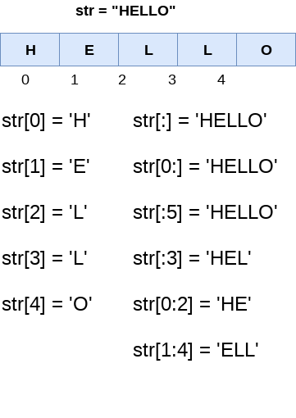
Python String
strings can be created by enclosing the character or the sequence of characters in the quotes. Python allows us to use single quotes, double quotes, or triple quotes to create the string.
str = "Hi Python !"
print(type(str)) # check the type of the variable str using a python script.
Strings indexing and splitting : indexing of the python strings starts from 0. For
example, The string "HELLO" is indexed as given in the below figure.

Slide 39
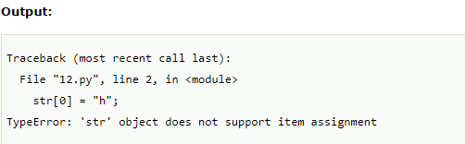
Reassigning String
Updating the content of the strings is as easy as assigning it to a new string. The string object doesn't support item assignment i.e., A string can only be replaced with a new string since its content can not be partially replaced. Strings are immutable in python.
Example :
str = "HELLO"
str[0] = "h"
print(str)

Slide 40
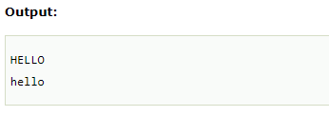
Reassigning String
Example 2 :
str = "HELLO"
print(str)
str = "hello"
print(str)

Slide 41
String Operators
str = "Hello"
str1 = " world"
print(str*3) # prints HelloHelloHello
print(str+str1)# prints Hello world
print(str[4]) # prints o
print(str[2:4]); # prints ll
print('w' in str) # prints false as w is not present in str
print('wo' not in str1) # prints false as wo is present in str1.
print("The string str : %s"%(str)) # prints The string str : Hello

Slide 42
Python List
A list can be defined as a collection of values or items of different types. The items in the list are separated with the comma (,) and enclosed with the square brackets [].
L1 = ["John", 102, "USA"]
L2 = [1, 2, 3, 4, 5, 6]
L3 = [1, "Ryan"]
Print(L1)
Print(L2)
Print(L3)
Print(type(L1))
Print(type(L2))
Print(type(L3))

Slide 43
List indexing and splitting
The elements of the list can be accessed by using the slice operator [].
The index starts from 0 and goes to length - 1. The first element of the list is stored at the 0th index, the second element of the list is stored at the 1st index, and so on.

Slide 44
Updating List values
List = [1, 2, 3, 4, 5, 6]
print(List)
List[2] = 10;
print(List)
List[1:3] = [89, 78]
print(List)
following example to delete the list elements.
List = [0,1,2,3,4]
print(List)
del List[0]
print(List)
del List[3]
print(List)

Slide 45
Python List Operations
The concatenation (+) and repetition (*) operator work in the same way as they were working with the strings.
Consider a List l1 = [1, 2, 3, 4], and l2 = [5, 6, 7, 8]
Operator | Description | Example
Repetition | The repetition operator enables the list elements to be repeated multiple times. | L1*2 = [1, 2, 3, 4, 1, 2, 3, 4]
Concatenation | It concatenates the list mentioned on either side of the operator. | l1+l2 = [1, 2, 3, 4, 5, 6, 7, 8]
Membership | It returns true if a particular item exists in a particular list otherwise false. | print(2 in l1) prints True.
Iteration | The for loop is used to iterate over the list elements. | for i in l1: print(i)Output1 2 3 4
Length | It is used to get the length of the list | len(l1) = 4

Slide 46
Iterating a List
A list can be iterated by using a for - in loop. A simple list containing four strings can be iterated as follows.
List = [“Anand", “Raj", “Sam", “Siri"]
for i in List: #i will iterate over the elements of the List
print(i);

Slide 47
Adding elements to the list
Python provides append() function by using which we can add an element to the list. However, the append() method can only add the value to the end of the list.
Consider the following example in which, we are taking the elements of the list from the user and printing the list on the console.
l =[];
n = int(input("Enter the number of elements in the list"));
for i in range(0,n): # for loop to take the input
l.append(input("Enter the item?")); # The input is taken from the user
print("printing the list items....");
for i in l: # traversal loop to print the list items
print(i, end = " ");

Slide 48
Removing elements from the list
List = [0,1,2,3,4]
print("printing original list: ");
for i in List:
print(i,end=" ")
List.remove(0)
print("\nprinting the list after the removal of first element...")
for i in List:
print(i,end=" ")

Slide 49
Python List Built-in functions
SNo | Function | Description
1 | cmp(list1, list2) | It compares the elements of both the lists.
2 | len(list) | It is used to calculate the length of the list.
3 | max(list) | It returns the maximum element of the list.
4 | min(list) | It returns the minimum element of the list.
5 | list(seq) | It converts any sequence to the list.

Slide 50
Python Tuple
Python Tuple is used to store the sequence of immutable python objects. Tuple is similar to lists since the value of the items stored in the list can be changed whereas the tuple is immutable and the value of the items stored in the tuple can not be changed.
A tuple can be written as the collection of comma-separated values enclosed with the small brackets.
Example:
tuple1 = (10, 20, 30, 40, 50, 60)
print(tuple1)
count = 0
for i in tuple1:
print("tuple1[%d] = %d"%(count, i));

Slide 51
Python Tuple
Example 2:
tuple1 = tuple(input("Enter the tuple elements ..."))
print(tuple1)
count = 0
for i in tuple1:
print("tuple1[%d] = %s"%(count, i));
Note:
if we try to reassign the items of a tuple, we would get an error
An empty tuple can be written as -- T3 = ()
tuple having a single value must include a comma as -- T4 = (90,)

Slide 52
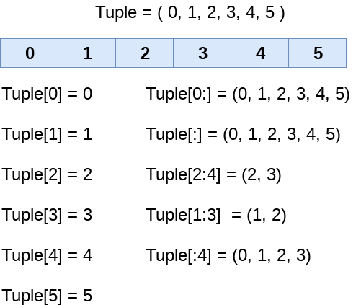
Tuple indexing and splitting
The indexing and slicing in tuple are similar to lists. The indexing in the tuple starts from 0 and goes to length(tuple) - 1.

Slide 53
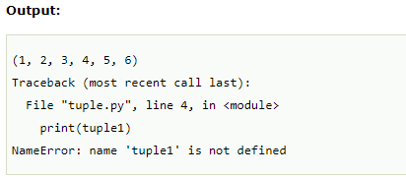
Tuples
Unlike lists, the tuple items can not be deleted by using the del keyword as tuples are immutable. To delete an entire tuple, we can use the del keyword with the tuple name.
tuple1 = (1, 2, 3, 4, 5, 6)
print(tuple1)
del tuple1[0]
print(tuple1)
del tuple1
print(tuple1)

Slide 54
Basic Tuple operations
The operators like concatenation (+), repetition (*), Membership (in) works in the same way as they work with the list. Consider the following table for more detail.
Let's say Tuple t = (1, 2, 3, 4, 5) and Tuple t1 = (6, 7, 8, 9) are declared.
Operator | Description | Example
Repetition | The repetition operator enables the tuple elements to be repeated multiple times. | T1*2 = (1, 2, 3, 4, 5, 1, 2, 3, 4, 5)
Concatenation | It concatenates the tuple mentioned on either side of the operator. | T1+T2 = (1, 2, 3, 4, 5, 6, 7, 8, 9)
Membership | It returns true if a particular item exists in the tuple otherwise false. | print (2 in T1) prints True.
Iteration | The for loop is used to iterate over the tuple elements. | for i in T1: print(i)Output1 2 3 4 5
Length | It is used to get the length of the tuple. | len(T1) = 5

Slide 55
Python Tuple inbuilt functions
SN | Function | Description
1 | cmp(tuple1, tuple2) | It compares two tuples and returns true if tuple1 is greater than tuple2 otherwise false.
2 | len(tuple) | It calculates the length of the tuple.
3 | max(tuple) | It returns the maximum element of the tuple.
4 | min(tuple) | It returns the minimum element of the tuple.
5 | tuple(seq) | It converts the specified sequence to the tuple.

Slide 56
List VS Tuple
SN | List | Tuple
1 | The literal syntax of list is shown by the []. | The literal syntax of the tuple is shown by the ().
2 | The List is mutable. | The tuple is immutable.
3 | The List has the variable length. | The tuple has the fixed length.
4 | The list provides more functionality than tuple. | The tuple provides less functionality than the list.
5 | The list Is used in the scenario in which we need to store the simple collections with no constraints where the value of the items can be changed. | The tuple is used in the cases where we need to store the read-only collections i.e., the value of the items can not be changed. It can be used as the key inside the dictionary.

Slide 57
Python sets
The set in python can be defined as the unordered collection of various items enclosed within the curly braces. The elements of the set can not be duplicate. The elements of the python set must be immutable.
There is no index attached to the elements of the set, i.e., we cannot directly access any element of the set by the index. However, we can print them all together or we can get the list of elements by looping through the set.
Creating a set:
The set can be created by enclosing the comma separated items with the curly braces. Python also provides the set method which can be used to create the set by the passed sequence.

Slide 58
Python sets
Creating a set:
The set can be created by enclosing the comma separated items with the curly braces. Python also provides the set method which can be used to create the set by the passed sequence.
Example:
Days = {"Monday", "Tuesday", "Wednesday", "Thursday", "Friday", "Saturday", "Sunday"}
print(Days)
print(type(Days))
print("looping through the set elements ... ")
for i in Days:
print(i)

Slide 59
Python sets
Creating a set: Using a set() Method
Days = set(["Monday", "Tuesday", "Wednesday", "Thursday", "Friday", "Saturday", "Sunday"])
print(Days)
print(type(Days))
print("looping through the set elements ... ")
for i in Days:
print(i)

Slide 60
Python sets
Adding items to the set
Python provides the add() method which can be used to add some particular item to the set.
Months = set(["January","February", "March", "April", "May", "June"])
print("\nprinting the original set ... ")
print(Months)
print("\nAdding other months to the set...");
Months.add("July");
Months.add("August");
print("\nPrinting the modified set...");
print(Months)
print("\nlooping through the set elements ... ")
for i in Months:
print(i)

Slide 61
Python sets
Adding items to the set
To add more than one item in the set, Python provides the update() method.
Months = set(["January","February", "March", "April", "May", "June"])
print("\nprinting the original set ... ")
print(Months)
print("\nupdating the original set ... ")
Months.update(["July","August","September","October"]);
print("\nprinting the modified set ... ")
print(Months);

Slide 62
Python sets
Removing items from the set
Python provides discard() method which can be used to remove the items from the set.
Months = set(["January","February", "March", "April", "May", "June"])
print("\nprinting the original set ... ")
print(Months)
print("\nRemoving some months from the set...");
Months.discard("January");
Months.discard("May");
print("\nPrinting the modified set...");
print(Months)
print("\nlooping through the set elements ... ")
for i in Months:
print(i)

Slide 63
Python sets
Removing items from the set
Python also provide the remove() method to remove the items from the set.
Months = set(["January","February", "March", "April", "May", "June"])
print("\nprinting the original set ... ")
print(Months)
print("\nRemoving some months from the set...");
Months.remove("January");
Months.remove("May");
print("\nPrinting the modified set...");
print(Months)
If the key to be deleted from the set using discard() doesn't exist in the set, the python will not give the error. The program maintains its control flow.
On the other hand, if the item to be deleted from the set using remove() doesn't exist in the set, the python will give the error.

Slide 64
Python sets
Removing items from the set
We can also use the pop() method to remove the item. However, this method will always remove the last item.
Months = set(["January","February", "March", "April", "May", "June"])
print("\nprinting the original set ... ")
print(Months)
print("\nRemoving some months from the set...");
Months.pop();
Months.pop();
print("\nPrinting the modified set...");
print(Months)

Slide 65
Python sets
Removing items from the set
Python provides the clear() method to remove all the items from the set.
Months = set(["January","February", "March", "April", "May", "June"])
print("\nprinting the original set ... ")
print(Months)
print("\nRemoving all the items from the set...");
Months.clear()
print("\nPrinting the modified set...")
print(Months)

Slide 66
Union of two Sets
The union of two sets are calculated by using the or (|) operator. The union of the two sets contains the all the items that are present in both the sets.
Example 1 : using union | operator
Days1 = {"Monday","Tuesday","Wednesday","Thursday"}
Days2 = {"Friday","Saturday","Sunday"}
print(Days1|Days2) #printing the union of the sets
Example 2: using union() method
Days1 = {"Monday","Tuesday","Wednesday","Thursday"}
Days2 = {"Friday","Saturday","Sunday"}
print(Days1.union(Days2)) #printing the union of the sets

Slide 67
Intersection of two sets
The & (intersection) operator is used to calculate the intersection of the two sets in python. The intersection of the two sets are given as the set of the elements that common in both sets.
Example 1: using & operator
set1 = {"Ayush","John", "David", "Martin"}
set2 = {"Steve","Milan","David", "Martin"}
print(set1&set2) #prints the intersection of the two sets
Example 2: using intersection() method
set1 = {"Ayush","John", "David", "Martin"}
set2 = {"Steave","Milan","David", "Martin"}
print(set1.intersection(set2)) #prints the intersection of the two sets

Slide 68
Intersection of two sets
The intersection_update() method
The intersection_update() method removes the items from the original set that are not present in both the sets (all the sets if more than one are specified).
The Intersection_update() method is different from intersection() method since it modifies the original set by removing the unwanted items, on the other hand, intersection() method returns a new set.
a = {"ayush", "bob", "castle"}
b = {"castle", "dude", "emyway"}
c = {"fuson", "gaurav", "castle"}
a.intersection_update(b, c)
print(a)

Slide 69
Difference of two sets
The difference of two sets can be calculated by using the subtraction (-) operator. The resulting set will be obtained by removing all the elements from set 1 that are present in set 2.
Example 1 : using subtraction ( - ) operator
Days1 = {"Monday", "Tuesday", "Wednesday", "Thursday"}
Days2 = {"Monday", "Tuesday", "Sunday"}
print(Days1-Days2) #{"Wednesday", "Thursday" will be printed}
Example 2 : using difference() method
Days1 = {"Monday", "Tuesday", "Wednesday", "Thursday"}
Days2 = {"Monday", "Tuesday", "Sunday"}
print(Days1.difference(Days2)) # prints the difference of the two sets Days1 and Days2.

Slide 70
Set comparisons
Python allows us to use the comparison operators i.e., <, >, <=, >= , == with the sets by using which we can check whether a set is subset, superset, or equivalent to other set. The boolean true or false is returned depending upon the items present inside the sets.
Days1 = {"Monday", "Tuesday", "Wednesday", "Thursday"}
Days2 = {"Monday", "Tuesday"}
Days3 = {"Monday", "Tuesday", "Friday"}
#Days1 is the superset of Days2 hence it will print true.
print (Days1>Days2)
#prints false since Days1 is not the subset of Days2
print (Days1<Days2)
#prints false since Days2 and Days3 are not equivalent
print (Days2 == Days3)

Slide 71
Dictionary
Python dictionary is an unordered collection of items. Each item of a dictionary has a key/value pair.
Dictionaries are optimized to retrieve values when the key is known.
An item has a key and a corresponding value that is expressed as a pair (key: value).
# dictionary with integer keys
my_dict = {1: 'apple', 2: 'ball’}
# dictionary with mixed keys
my_dict = {'name': 'John', 1: [2, 4, 3]}
# using dict()
my_dict = dict({1:'apple', 2:'ball’})
# from sequence having each item as a pair
my_dict = dict([(1,'apple'), (2,'ball')])

Slide 72
Dictionary - Create
squares = {1: 1, 2: 4, 3: 9, 4: 16, 5: 25}
print(s[3])
print(d1.keys())
print(d1.values())
print(len(squares))
d1 = {'Name': ‘Lakshmi', 'Age’: 21, 'Class': 'First’}
print(d1[‘name])
print(d1[‘age’])
print(d1[‘class’])

Slide 73
Updating Dictionary
You can update a dictionary by adding a new entry or a key-value pair, modifying an existing entry, or deleting an existing entry.
d1 = {'Name': ‘Lakshmi', 'Age’: 21, 'Class': 'First’}
d1['Age'] = 23
squares = {1: 1, 2: 4, 3: 9, 4: 16, 5: 25}
squares[1]=3
squares

Slide 74
Adding Items - Dictionary
Adding an item to the dictionary is done by using a new index key and assigning a value to it.
d1 = {'Name': ‘Lakshmi', 'Age’: 21, 'Class': 'First’}
D1[‘gender’]= ‘female’
Print(d1)

Slide 75
Removing Items - Dictionary
The pop() method removes the item with the specified key name
d1 = {'Name': ‘Lakshmi', 'Age’: 21, 'Class': 'First’}
d1.pop(“class”)
Print(d1)
The del keyword removes the item with the specified key name
del d1[“age”]

Slide 76
Change Keys - Dictionary
Method 1:
d1={1:2,2:4,3:6}
d1[8]=d1[1]
d1
{1: 2, 2: 4, 3: 6, 8: 2}
del d1[1]
Method 2:
d1[11]=d1.pop(2)

Slide 77
Change Keys - Dictionary
# Using for loop getting the keys
d1 = {"Name":"Lakshmi", "Age": 21, "Class": "First"}
for i in d1.keys():
print(i)
# Using for loop getting the keys
for i in d1.values():
print(i)
# Using for loop getting the keys, values
for k,v in d1.items():
print(k,":",v)
print(k,v)

Slide 78
Dictionary - Methods
METHODS | DESCRIPTION
copy() | They copy() method returns a shallow copy of the dictionary.
clear() | The clear() method removes all items from the dictionary.
pop() | Removes and returns an element from a dictionary having the given key.
popitem() | Removes the arbitrary key-value pair from the dictionary and returns it as tuple.
get() | It is a conventional method to access a value for a key.
dictionary_name.values() | returns a list of all the values available in a given dictionary.
str() | Produces a printable string representation of a dictionary.
update() | Adds dictionary dict2’s key-values pairs to dict
setdefault() | Set dict[key]=default if key is not already in dict
keys() | Returns list of dictionary dict’s keys
items() | Returns a list of dict’s (key, value) tuple pairs
has_key() | Returns true if key in dictionary dict, false otherwise
fromkeys() | Create a new dictionary with keys from seq and values set to value.
type() | Returns the type of the passed variable.
cmp() | Compares elements of both dict.

Slide 79
FrozenSets
The frozen sets are the immutable form of the normal sets, i.e., the items of the frozen set can not be changed and therefore it can be used as a key in dictionary.
The elements of the frozen set can not be changed after the creation. We cannot change or append the content of the frozen sets by using the methods like add() or remove().
The frozenset() method is used to create the frozenset object. The iterable sequence is passed into this method which is converted into the frozen set as a return type of the method.
Frozenset = frozenset([1,2,3,4,5])
print(type(Frozenset))
print("\nprinting the content of frozen set...")
for i in Frozenset:
print(i);
Frozenset.add(6) #gives an error, we cannot change the content.

Slide 80
The if statement
In python, decision making is performed by the following statements.
Statement | Description
If Statement | The if statement is used to test a specific condition. If the condition is true, a block of code (if-block) will be executed.
If - else Statement | The if-else statement is similar to if statement except the fact that, it also provides the block of the code for the false case of the condition to be checked. If the condition provided in the if statement is false, then the else statement will be executed.
Nested if Statement | Nested if statements enable us to use if ? else statement inside an outer if statement.

Slide 81
Indentation in Python
For the ease of programming and to achieve simplicity, python doesn't allow the use of parentheses for the block level code. In Python, indentation is used to declare a block. If two statements are at the same indentation level, then they are the part of the same block.

Slide 82

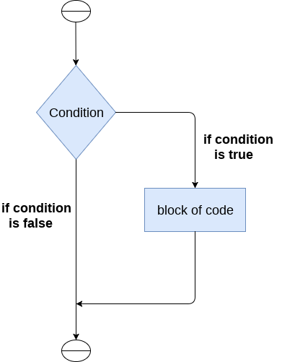
The if statement is used to test a particular condition and if the condition is true, it executes a block of code known as if-block. The condition of if statement can be any valid logical expression which can be either evaluated to true or false.

Slide 83
The syntax of the if-statement is…
if expression:
statement
Example 1:
num = int(input("enter the number?"))
if num%2 == 0:
print("Number is even")
Example 1:
a = int(input("Enter a? "));
b = int(input("Enter b? "));
c = int(input("Enter c? "));
if a>b and a>c:
print("a is largest");
if b>a and b>c:
print("b is largest");
if c>a and c>b:
print("c is largest");

Slide 84
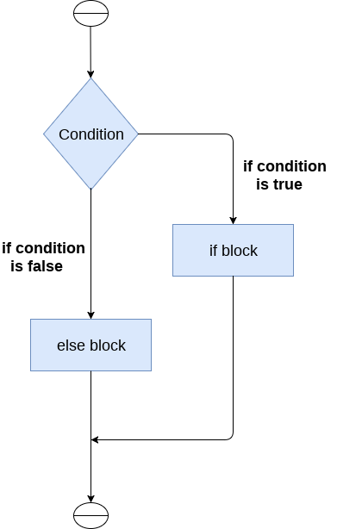
The if-else statement
The if-else statement provides an else block combined with the if statement which is executed in the false case of the condition.
If the condition is true, then the if-block is executed. Otherwise, the else-block is executed.

Slide 85
The syntax of the if-else statement is given below.
if condition:
#block of statements
else:
#another block of statements (else-block)
Example 1 : Program to check whether a person is eligible to vote or not.
age = int (input("Enter your age? "))
if age>=18:
print("You are eligible to vote !!");
else:
print("Sorry! you have to wait !!");

Slide 86
Example 2: Program to check whether a number is even or not.
num = int(input("enter the number?"))
if num%2 == 0:
print("Number is even...")
else:
print("Number is odd...")

Slide 87
The elif statement
The elif statement works like an if-else-if ladder statement in C. It must be succeeded by an if statement.
The syntax of the elif statement is
if expression 1:
# block of statements
elif expression 2:
# block of statements
elif expression 3:
# block of statements
else:
# block of statements

Slide 88

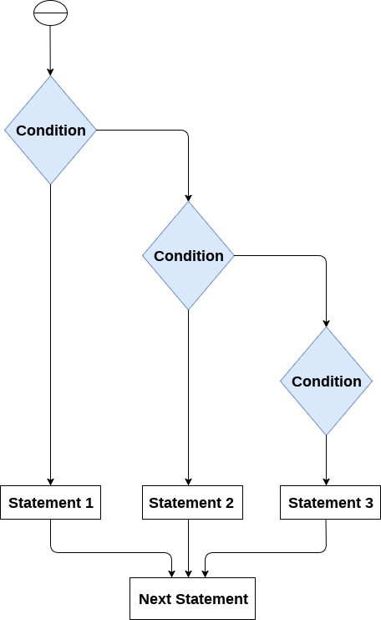

Slide 89
Example 1:
number = int(input("Enter the number?"))
if number==10:
print("number is equals to 10")
elif number==50:
print("number is equal to 50")
elif number==100:
print("number is equal to 100")
else:
print("number is not equal to 10, 50 or 100")

Slide 90
Example 2:
marks = int(input("Enter the marks? "))
if marks > 85 and marks <= 100:
print("Congrats ! you scored grade A ...")
elif marks > 60 and marks <= 85:
print("You scored grade B + ...")
elif marks > 40 and marks <= 60:
print("You scored grade B ...")
elif (marks > 30 and marks <= 40):
print("You scored grade C ...")
else:
print("Sorry you are fail ?")

Slide 91
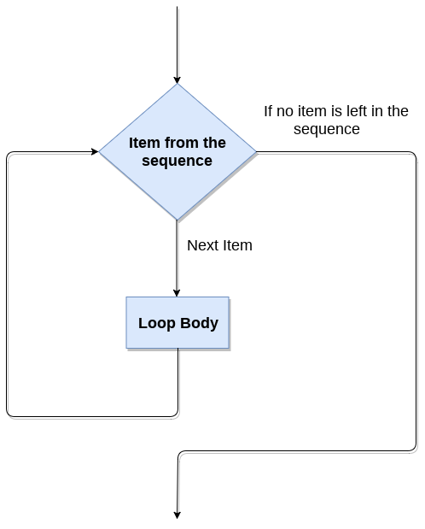
The for Loop
The for loop in Python is used to iterate the statements or a part of the program several times. It is frequently used to traverse the data structures like list, tuple, or dictionary.
The syntax of for loop in python is given below.
for iterating_var in sequence:
statement(s)

Slide 92
The for Loop
Example 1: Printing the Numbers
i=1
n=int(input("Enter the number up to which you want to print the numbers?"))
for i in range(0,10):
print(i,end = ' ')
Example 2: Printing the table of the given number
i=1;
num = int(input("Enter a number:"));
for i in range(1,11):
print("%d X %d = %d"%(num,i,num*i));

Slide 93
Nested for Loop
Python allows us to nest any number of for loops inside a for loop. The inner loop is executed n number of times for every iteration of the outer loop. The syntax of the nested for loop in python is
for iterating_var1 in sequence:
for iterating_var2 in sequence:
#block of statements
#Other statements
Example 1:
n = int(input("Enter the number of rows you want to print?"))
i,j=0,0
for i in range(0,n):
print()
for j in range(0,i+1):
print("*",end="")

Slide 94
Using else statement with for loop
Unlike other languages like C, C++, or Java, python allows us to use the else statement with the for loop which can be executed only when all the iterations are exhausted. Here, we must notice that if the loop contains any of the break statement then the else statement will not be executed.
Example:
for i in range(0,5):
print(i)
else:print("for loop completely exhausted, since there is no break.");
In the above example, for loop is executed completely since there is no break statement in the loop. The control comes out of the loop and hence the else block is executed.

Slide 95
Using else statement with for loop
Example 2:
for i in range(0,5):
print(i)
break;
else:print("for loop is exhausted");
print("The loop is broken due to break statement...came out of loop")
In the above example, the loop is broken due to break statement therefore the else statement will not be executed. The statement present immediate next to else block will be executed.

Slide 96
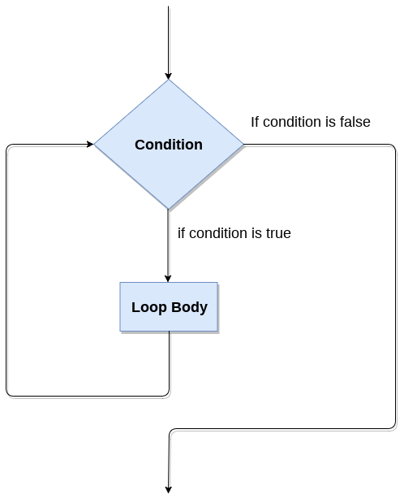
while loop
The while loop is also known as a pre-tested loop. In general, a while loop allows a part of the code to be executed as long as the given condition is true.
The syntax is
while expression:
statements

Slide 97
while loop
Example 1:
i=1;
while i<=10:
print(i);
i=i+1;
Example 2:
i=1
number=0
b=9
number = int(input("Enter the number?"))
while i<=10:
print("%d X %d = %d \n"%(number,i,number*i));
i = i+1;

Slide 98
Using else with while loop
Python enables us to use the while loop with the while loop also. The else block is executed when the condition given in the while statement becomes false. Like for loop, if the while loop is broken using break statement, then the else block will not be executed and the statement present after else block will be executed.
Example 1:
i=1;
while i<=5:
print(i)
i=i+1;
else:print("The while loop exhausted");
Example 2:
i=1;
while i<=5:
print(i)
i=i+1;
if(i==3):
break;
else:print("The while loop exhausted");

Slide 99
break statement
The break is a keyword in python which is used to bring the program control out of the loop.
Example 1:
list =[1,2,3,4]
count = 1;
for i in list:
if i == 4:
print("item matched")
count = count + 1;
break
print("found at",count,"location");

Slide 100
break statement
Example 2:
i = 0;
while 1:
print(i," ",end=""),
i=i+1;
if i == 10:
break;
print("came out of while loop");

Slide 101
Continue statement
The continue statement skips the remaining lines of code inside the loop and start with the next iteration.
Example 1:
i = 0;
while i!=10:
print("%d"%i);
continue;
i=i+1;
Example 2:
i=1; #initializing a local variable
for i in range(1,11):
if i==5:
continue;
print("%d"%i);

Slide 102
pass statement
pass keyword is used to execute nothing; it means, when we don't want to execute code, the pass can be used to execute empty. It is same as the name refers to. It just makes the control to pass by without executing any code. If we want to bypass any code pass statement can be used.
Example :
for i in [1,2,3,4,5]:
if i==3:
pass
print "Pass when value is",i
print(i)

Slide 103
Python – functions
A function is a block of code which only runs when it is called.
You can pass data, known as parameters, into a function.
A function can return data as a result.
Syntax of Function
def function_name(parameters):
statement(s)

Slide 104
Python – functions
A function definition consists of the following components.
Keyword def that marks the start of the function header.
A function name to uniquely identify the function. Function naming follows the same rules of writing identifiers in python.
Parameters (arguments) through which we pass values to a function. They are optional.
A colon (:) to mark the end of the function header.
One or more valid python statements that make up the function body. Statements must have the same indentation level (usually 4 spaces).
An optional return statement to return a value from the function.

Slide 105
Python – functions
Calling a Function
To call a function, use the function name followed by parenthesis:
def function_name(): # Function definition print("Hello from a function") function_name() # Function Call

Slide 106
Python – functions
Function Arguments
Information can be passed into functions as arguments.
Arguments are specified after the function name, inside the parentheses. You can add as many arguments as you want, just separate them with a comma.
Example:
def my_function(fname): print(fname + " DataScience") my_function(“Rajesh") my_function(“Vallabha") my_function(“Harika")

Slide 107
Python – functions
Function Arguments
A function must be called with the correct number of arguments. Meaning that if your function expects 2 arguments, you have to call the function with 2 arguments, not more, and not less.
Example:
def my_function(fname, lname): print(fname + " " + lname) my_function(“Sree", “Lakshmi")

Slide 108
Python – functions
Function Arguments - Arbitrary Arguments, *args
If you do not know how many arguments that will be passed into your function, add a * before the parameter name in the function definition.
This way the function will receive a tuple of arguments, and can access the items accordingly
Example:
def myfun(*args):
for arg in args:
print(arg)
myfun("ram","kumar","hello")

Slide 109
Python – functions
Types of Function Arguments
You can call a function by using the following types of formal arguments
Required arguments
Keyword arguments
Default arguments
Variable-length arguments

Slide 110
Python – functions
Types of Function Arguments - Required arguments
Required arguments are the arguments passed to a function in correct positional order. Here, the number of arguments in the function call should match exactly with the function definition.
Example:
# Function definition is here
def printme( str ):
"This prints a passed string into this function"
print str
return;
# Now you can call printme function
printme(str = "My string" )

Slide 111
Python – functions
Types of Function Arguments - Keyword arguments
Keyword arguments are related to the function calls. When you use keyword arguments in a function call, the caller identifies the arguments by the parameter name.
This allows you to skip arguments or place them out of order because the Python interpreter is able to use the keywords provided to match the values with parameters.
def printinfo( name, age ):
"This prints a passed info into this function"
print "Name: ", name
print "Age ", age
return;
# Now you can call printinfo function printinfo( age=50, name="miki" )

Slide 112
Python – functions
Types of Function Arguments - Default arguments
A default argument is an argument that assumes a default value if a value is not provided in the function call for that argument. The following example gives an idea on default arguments, it prints default age if it is not passed.
Example:
def printinfo( name, age = 35 ):
"This prints a passed info into this function“
print "Name: ",name
print "Age ", age
return;
# Now you can call printinfo function
printinfo( age=50, name="miki" )
printinfo( name="miki" )

Slide 113
Python – functions
Types of Function Arguments - Variable-length arguments
You may need to process a function for more arguments than you specified while defining the function. These arguments are called variable-length arguments and are not named in the function definition, unlike required and default arguments.
Example 1 : *args
def myfun(*args):
for arg in args:
print(arg)
myfun("ram","kumar","hello")

Slide 114
Example 2 : # Python program to illustrate
# *args with first extra argument
def myfun(arg1, *args):
print ("First argument :", arg1)
for arg in args:
print("Next argument through *argv :", arg)
myfun("ram","kumar","hello")
Example 3 : # Python program to illustrate
# *kargs for variable number of keyword arguments
def myfun(**kwargs):
for k, v in kwargs.items():
print ("%s == %s" %(k, v))
# Driver code
myfun(first ='ram', mid ='kumar', last='Hello')

Slide 115
Python – functions
Types of Function Arguments - **kwargs
The special syntax **kwargs in function definitions in python is used to pass a keyworded, variable-length argument list. We use the name kwargs with the double star. The reason is because the double star allows us to pass through keyword arguments (and any number of them).
A keyword argument is where you provide a name to the variable as you pass it into the function.
One can think of the kwargs as being a dictionary that maps each keyword to the value that we pass alongside it. That is why when we iterate over the kwargs there doesn’t seem to be any order in which they were printed out.

Slide 116
Python – functions
Types of Function Arguments - **kwargs
Example:
def myfun(*args):
for arg in args:
print(arg)
myfun("ram","kumar","hello")

Slide 117
Example 4 : # Python program to illustrate **kargs for
# variable number of keyword arguments with
# one extra argument.
def myfun(arg1, **kwargs):
for key, value in kwargs.items():
print ("%s == %s" %(key, value))
# Driver code
myfun("Hi", first ='Ram', mid ='Kumar', last='Hello’)

Slide 118
Example 5 : Using *args and **kwargs to call a function
def myfun(arg1, arg2, arg3):
print("arg1:", arg1)
print("arg2:", arg2)
print("arg3:", arg3)
# Now we can use *args or **kwargs to
# pass arguments to this function :
args = ("Ram", "Kumar", "Hello")
myfun(*args)
kwargs = {"arg1" : "Hello", "arg2" : "Ram", "arg3" : "Kumar"}
myfun(**kwargs)

Slide 119
Example 6 : Using *args and **kwargs in same line to call a function
def myfun(*args,**kwargs):
print("args: ", args)
print("kwargs: ", kwargs)
# Now we can use both *args ,**kwargs to pass arguments to this function :
myfun('Ram','Kumar','Hello',first="How",mid="are",last="You")

Slide 120
Python – functions
Types of Function Arguments - **kwargs
Example:
def myfun(*args):
for arg in args:
print(arg)
myfun("ram","kumar","hello")

Slide 121
Python – Recursion
Recursion:
def fact(n):
if(n==0):
return 1
return n * fact(n-1)
result = fact(5)
print(result)

Slide 122
Lambda functions in Python
In Python, anonymous function means that a function is without a name. As we already know that def keyword is used to define the normal functions and the lambda keyword is used to create anonymous functions.
Lambda arguments: expression
This function can have any number of arguments but only one expression, which is evaluated and returned.
One is free to use lambda functions wherever function objects are required
Example: lambdaexp.py

Slide 123
Python – Class
A class is a user-defined prototype from which objects are created. Classes provide a means of bundling data and functionality together. Creating a new class creates a new type of object, allowing new instances of that type to be made.
Each class instance can have attributes attached to it for maintaining its state. Class instances can also have methods (defined by its class) for modifying its state.
Defining a class
class ClassName:
# Statement-1
. . .
# Statement-N

Slide 124
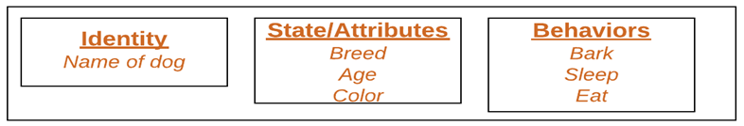
Python – Class
Class Objects
An Object is an instance of a Class. A class is like a blueprint while an instance is a copy of the class with actual values.
An object consists of :
State : It is represented by attributes of an object. It also reflects the properties of an object.
Behavior : It is represented by methods of an object. It also reflects the response of an object with other objects.
Identity : It gives a unique name to an object and enables one object to interact with other objects.

Slide 125
Python – Class
__init__ method
The __init__ method is similar to constructors in C++ and Java. Constructors are used to initialize the object’s state. Like methods, a constructor also contains a collection of statements(i.e. instructions) that are executed at the time of Object creation. It is run as soon as an object of a class is instantiated. The method is useful to do any initialization you want to do with your object.
# A Sample class with init method
class Person:
# init method or constructor
def __init__(self, name):
self.name = name
# Sample Method
def say_hi(self):
print('Hello, my name is', self.name)
p = Person('Nikhil')
p.say_hi()

Slide 126
Python – Class
Example:
class Person: def __init__(self, name, age): self.name = name self.age = age def myfunc(self): print("Hello my name is " + self.name) p1 = Person("John", 36) p1.myfunc()

Slide 127
Instance Variables and Class(Static) Variables
Instance variables are variables used for data that is unique to a particular instance.
Class Variables are variables that are shared by all instances of a class.
class cars:
wheels =4 # class variable
def __init__(self):
self.milage =22 # instance variables
self.company = "maruti"
c1=cars()
c2=cars()
c1.milage=18
#cars.wheels=3
print(c1.company,c1.milage,c1.wheels)
print(c2.company,c2.milage,c2.wheels)

Slide 128
Inner class
An Inner Class or nested class is defined entirely within the body of another class.
If an object is created using a class , the object inside the outer class can be used
Example: exam8.py

Slide 129
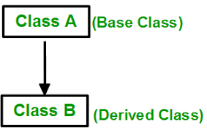
Single Inheritance
Inheritance allows us to define a class that inherits all the methods and properties from another class.
Parent class(Base class) is the class being inherited from, and
Child class(derived class) is the class that inherits from another class.
Example: exam9.py

Slide 130
Multi level Inheritance
Features of the base class and the derived class is inherited into the new derived class.
Example: exam9.py

Slide 131
Multiple Inheritance
The features of all the base classes are inherited into the derived class.
Example: exam9.py

Slide 132
Hierarchical Inheritance
More than one derived classes are created from a single base class
Example: exam9.py

Slide 133
Constructors
Constructors are special methods which are used to initialize the members of the class whenever we create an instance.
class Sample:
def __init__(self,a,b):
self.a=a
self.b=b
def show(self):
print(self.a,self.b)
obj1=Sample(2,7)
obj1.show()
Example: exam10.py

Slide 134
Constructors in Inheritance
In a single inheritance, if we are defining the init method, can be use in the child class.
If the child class also having init method, when you call child instance, it consider init in child class only.
To use parent init, we have to use super keyword, in init of child class
super.__init__()
Example: exam11.py

Slide 135
Constructors –Method resolution order(MRO)
In multiple Inheritance, the child class is derived from two base classes.
In this case, when we are using super, it is going to take init of first base class.(from left to right)
Example: exam12.py

Slide 136
Polymorphism
Polymorphism is the ability of an object to take on many forms.
There are 4 ways to implement the polymorphism.
Duck Typing
Operator overloading
Method overloading
Method overriding
Example: exam12.py

Slide 137
Polymorphism - Duck Typing
Duck Typing is a way of programming in which an object passed into a function or method supports all method signatures and attributes expected of that object at run time.
The object's type itself is not important. Rather, the object should support all methods/attributes called on it.
Example: exam13.py

Slide 138
Polymorphism – Operator Overloading
An operator overloading perform an operation on one or more operands(values).
Python has many special functions like __add__()
Function | Method Description
__add__(self,other) | Addition
__sub__(self,other) | Subtraction
__mul__(self,other) | Multiplication
__mod__(self,other) | Remainder
__truediv__(self,other) | Division
__lt__(self,other) | Less than
__le__(self,other) | Less than or equal to
__eq__(self,other) | Equal to
__ne__(self,other) | Not equal to
__gt__(self,other) | Greater than
Example: exam14.py

Slide 139
Polymorphism – Method Overloading
In any other languages, in a class two methods with the same name but different arguments is called method overloading.
In python, we don’t have method overloading, but we can write similar to that.
Example: exam15.py

Slide 140
Polymorphism – Method Overriding
In any other languages, in the concept of Inheritance, in a base class and child class having the methods with the same name and same arguments is called method overriding.
Example: exam16.py

Slide 141
Exception Handling in Python
Errors:
Compile Time Errors – syntax errors and static semantic errors indicated by the compiler.
Syntax errors: errors due to the fact that the syntax of the language is not respected.
Semantic errors: errors due to an improper use of program statements.
2. Logical Errors - Errors due to the fact that the specification is not respected.
3. Runtime Errors - Dynamic semantic errors, and logical errors, that cannot be detected by the compiler.
Example: Divide by Zero, referencing missing files

Slide 142
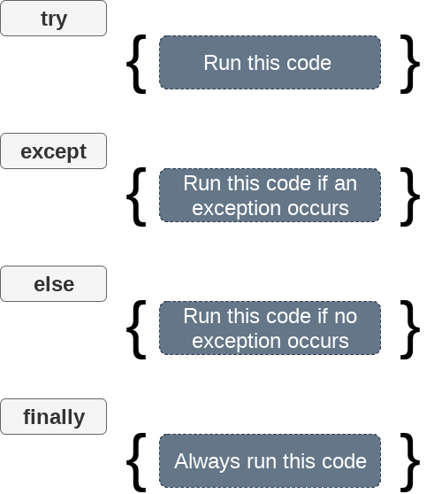
Exception Handling in Python
An exception Is an error that happens during execution of a program. When error occurs, Python generate an exception that can be handled, which avoids your program to crash.
Example: exam17.py

Slide 143
File Handling in Python
Python too supports file handling and allows users to handle files i.e., to read and write files, along with many other file handling options, to operate on files.
Python has several functions for creating, reading, updating, and deleting files.
The key function for working with files in Python is the open() function.
The open() function takes two parameters; filename, and mode.
There are four different methods (modes) for opening a file:
"r" - Read - Default value. Opens a file for reading, error if the file does not exist
"a" - Append - Opens a file for appending, creates the file if it does not exist
"w" - Write - Opens a file for writing, creates the file if it does not exist
"x" - Create - Creates the specified file, returns an error if the file exists
Example: exam18.py

Slide 144
Python – Decorators
Decorators:
Decorators are very powerful and useful tool in Python since it allows programmers to modify the behavior of function or class.
Decorators allow us to wrap another function in order to extend the behavior of wrapped function, without permanently modifying it.
Python has an interesting feature called decorators to add functionality to an existing code.
This is also called metaprogramming because a part of the program tries to modify another part of the program at compile time.
Example: exam21.py

Slide 145
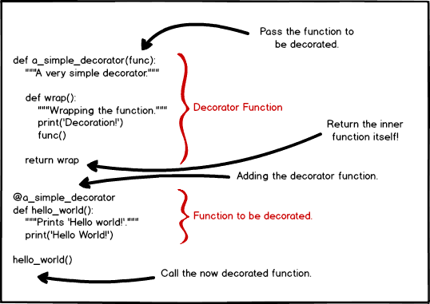
Python – Decorators
Example: exam21.py

Slide 146
Python – Iterators
An iterator is an object that can be iterated upon, meaning that you can traverse through all the values. Technically, in Python, an iterator is an object which implements the iterator protocol, which consist of the methods __iter__() and __next__() .
Example:
list1 = [1,3,4,5,6]
it1=iter(list1)
print(it1.__next__()) # prints the first value in the list
print(it1.__next__()) # prints the next value in the list
print(next(it1)) # other way of using iterator
Example: exam19.py

Slide 147
Python – Iterators
Creating a custom iterator
we can create an iterator by using the iter() method, in which we pass in an object. In the example above, we use a list to generate an iterable by calling iter([1, 2, 3]), which is equivalent to [1, 2, 3].__iter__(). This usage is similar to the built-in len() method, which is also known as __len__() method.
Example: exam19.py

Slide 148
Python – Generators
Generators:
A generator-function is defined like a normal function, but whenever it needs to generate a value, it does so with the yield keyword rather than return. If the body of a def contains yield, the function automatically becomes a generator function.
def topten():
yield 1
yield 2
# yield 3
# yield 4
values = topten()
print(values.__next__())
print(values.__next__())
Example: exam20.py

Slide 149
Python – Generators
Top ten Perfect Squares
def topten():
n = 1
while n <= 10:
sq = n*n
yield sq
n += 1
values = topten()
for i in values:
print(i)
Example: exam20.py

